Slide 1
Air Pollution Nationwide: Air Traffic and Ground Transportation
Project 3
Group Name: Still Breathing!
Group Members:
Zuhair Shahzad, Saniya Sule, Eric Meyer, Parag Patel, Bhavani Sathya

Slide 2
Objective of this Analysis

Slide 3
Data Dictionary
AIR TRAVEL
DEPARTURES PEFORMED – NUMBER OF FLIGHTS
PAYLOAD – COMBINED WEIGHT IN POUNDS OF ALL FLIGHTS IN THAT YEAR
PASSENGERS – TOTAL NUMBER OF PASSENGERS THAT WERE ON FLIGHTS IN THAT YEAR
RAMP-TO-RAMP/AIR TIME – TOTAL TIME FLOWN;EITHER FROM RAMP TO RAMP OR JUST IN AIR
TOTAL DISTANCE – TOTAL NUMBER OF MILES FLOWN FROM ALL FLIGHTS IN THAT YEAR
GROUND TRAVEL
COMMUTERS(1000s) – NUMBER OF COMMUTERS RECORDED DRIVEN OVER THAT YEAR
DAILY VEHICLE-MILES ON FREEWAY/ARTERIAL STREETS – AVERAGE NUMBER OF MILES DRIVEN PER DAY ON FREEWAY/LOCAL ROADS
FUEL CONSUMPTION(1000 GALLONS) – AMOUNT OF FUEL CONSUMED BY VEHICLES IN THAT YEAR

Slide 4
Machine Learning
Linear Regression Model
Decision Tree Classifier

Slide 5
Database
Transportation Dataset:
https://mobility.tamu.edu/umr/
Air traffic Dataset:
https://www.transtats.bts.gov/Fields.asp
Data Archive: Gross Domestic Product by Industry and Input-Output Statistics
https://apps.bea.gov/histdata/histChildLevels.cfm?HMI=8
Agricultural Productivity in the U.S
https://www.ers.usda.gov/data-products/agricultural-productivity-in-the-us/
U.S. Production and Business Activity
https://knoema.com/atlas/topics/Industrial-Production/datasets

Slide 6
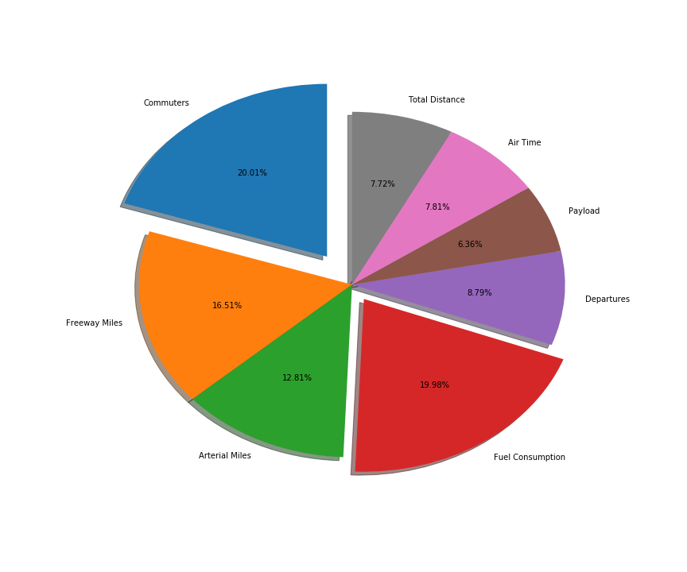
Air and Ground Transportation

Slide 7
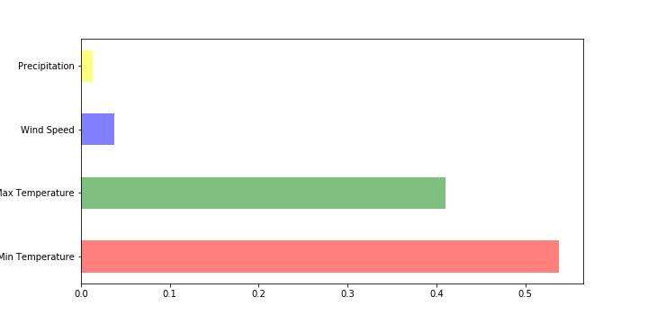
New York City Weather Temperature

Slide 8
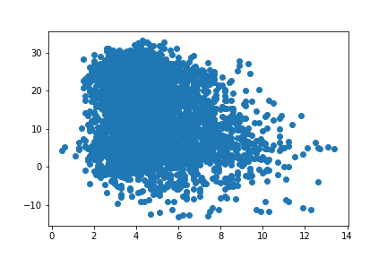
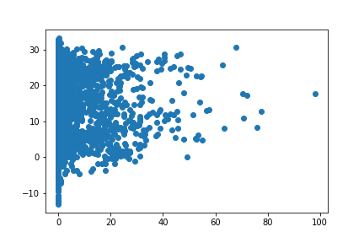
AWND & PRCP

Slide 9
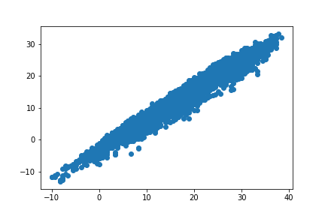
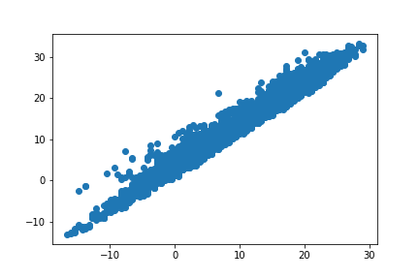
TMAX & TMIN

Slide 10
Conclusion

